Slide 1

RADV Risk Adjustment Data Validation Tool
FHIRed UP
Augusto Burgos aburgos3@gatech.edu Spiro Ganas spiroganas@gmail.com Anja Guillory anjag1993@gmail.com Jamie Richgels jrichgels3@gatech.edu Daniel Stoneburner dstoneburner3@gatech.edu Tala Suidan tmsuidan@gatech.edu
Notes:
This presentation describes RADV, the Risk Adjustment Data Validation tool developed by team FHIRed Up.

Slide 2
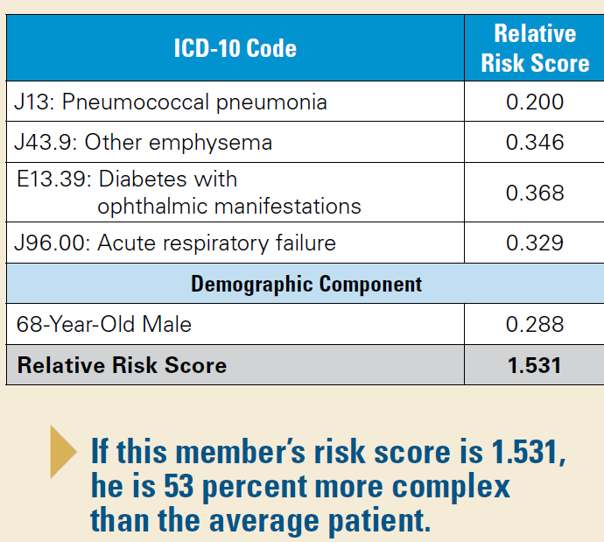
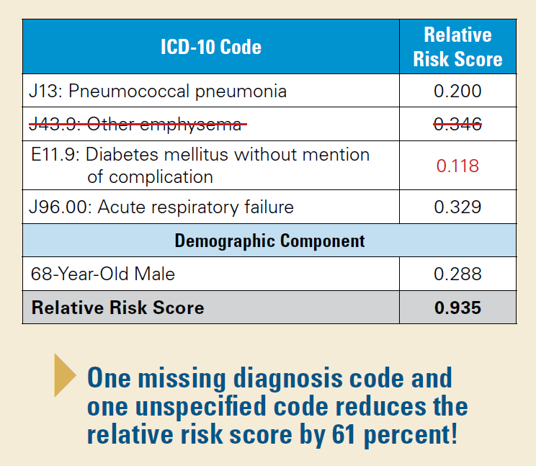
Executive Summary
Under ACA Risk Adjustment, missing or inaccurate data leads to lower provider reimbursement.
Source: https://www.bcbsal.org/providers/pdfs/riskAdjustment.pdf
Notes:
The Affordable Care Act requires health insurance companies to offer insurance to people with pre-existing conditions. By only offering policies with high co-pays and high-deductibles, insurance companies can discourage ill patients from purchasing their products. Risk adjustment prevents this by transferring premiums from insurers with healthy members to those organizations that are insuring for a more ill population.
Risk scores are use to determine the average level of illness in an insurers population. A risk score is calculated using the list of diagnoses recorded for a patient during the previous calendar year. This gives providers and insurers a strong financial interest in making medical records accurate and complete.
The RADV tool was designed to help providers validate medical records, by identifying health care conditions that may be missing from a patients recent medical record.

Slide 3
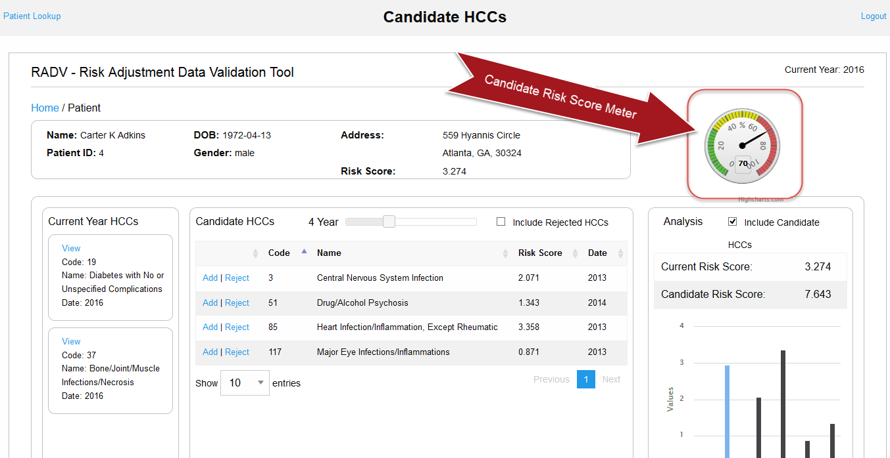
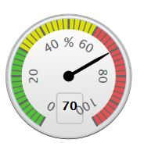

Candidate Risk Score Meter
Formula:
$$x\% =\left(1−\frac{Current Risk Score}{Sum \left(Candidate HCC Risk Scores\right)+Current Risk Score}\right)∗100\%$$
Example:
Given:
Current Risk Score: 0.723
Sum of Candidate Risk Scores:1.687
Results:
Risk Score Meter: 70
$$70\% =\left(1−\frac{0.723}{1.687+0.723}\right)∗100\%$$
The patient’s current risk score is 70% less then what it would be if their candidate HCCs where included.
Notes:
(NOTE: the formula and example are behind the screenshot, which disappears after a few seconds)
The candidate risk score meter (or gauge) is used to indicate the severity of the patient’s candidate risk score relative to their current risk score. It is used to quickly identify if the candidate HCCs would make a significant impact to the patient’s risk score, were they to be added to the patient.
Example:
If a patient has a Current Risk Score of 0.723 and the sum of their Candidate Risk Scores totals1.687, the candidate risk score meter would register 70, indicating the patient’s current risk score is 70% less then what it would be if the candidate HCCs where included.

Slide 4
RADV Application Demo
Notes:
We’re now going to show you a live demo of the RADV Candidate Risk Score Meter. The demo is of the live application hosted on Google App Engine interacting with Georgia Tech’s test FHIR server. The data is based on what is currently available in the server and reflects a real world scenario.

Slide 5
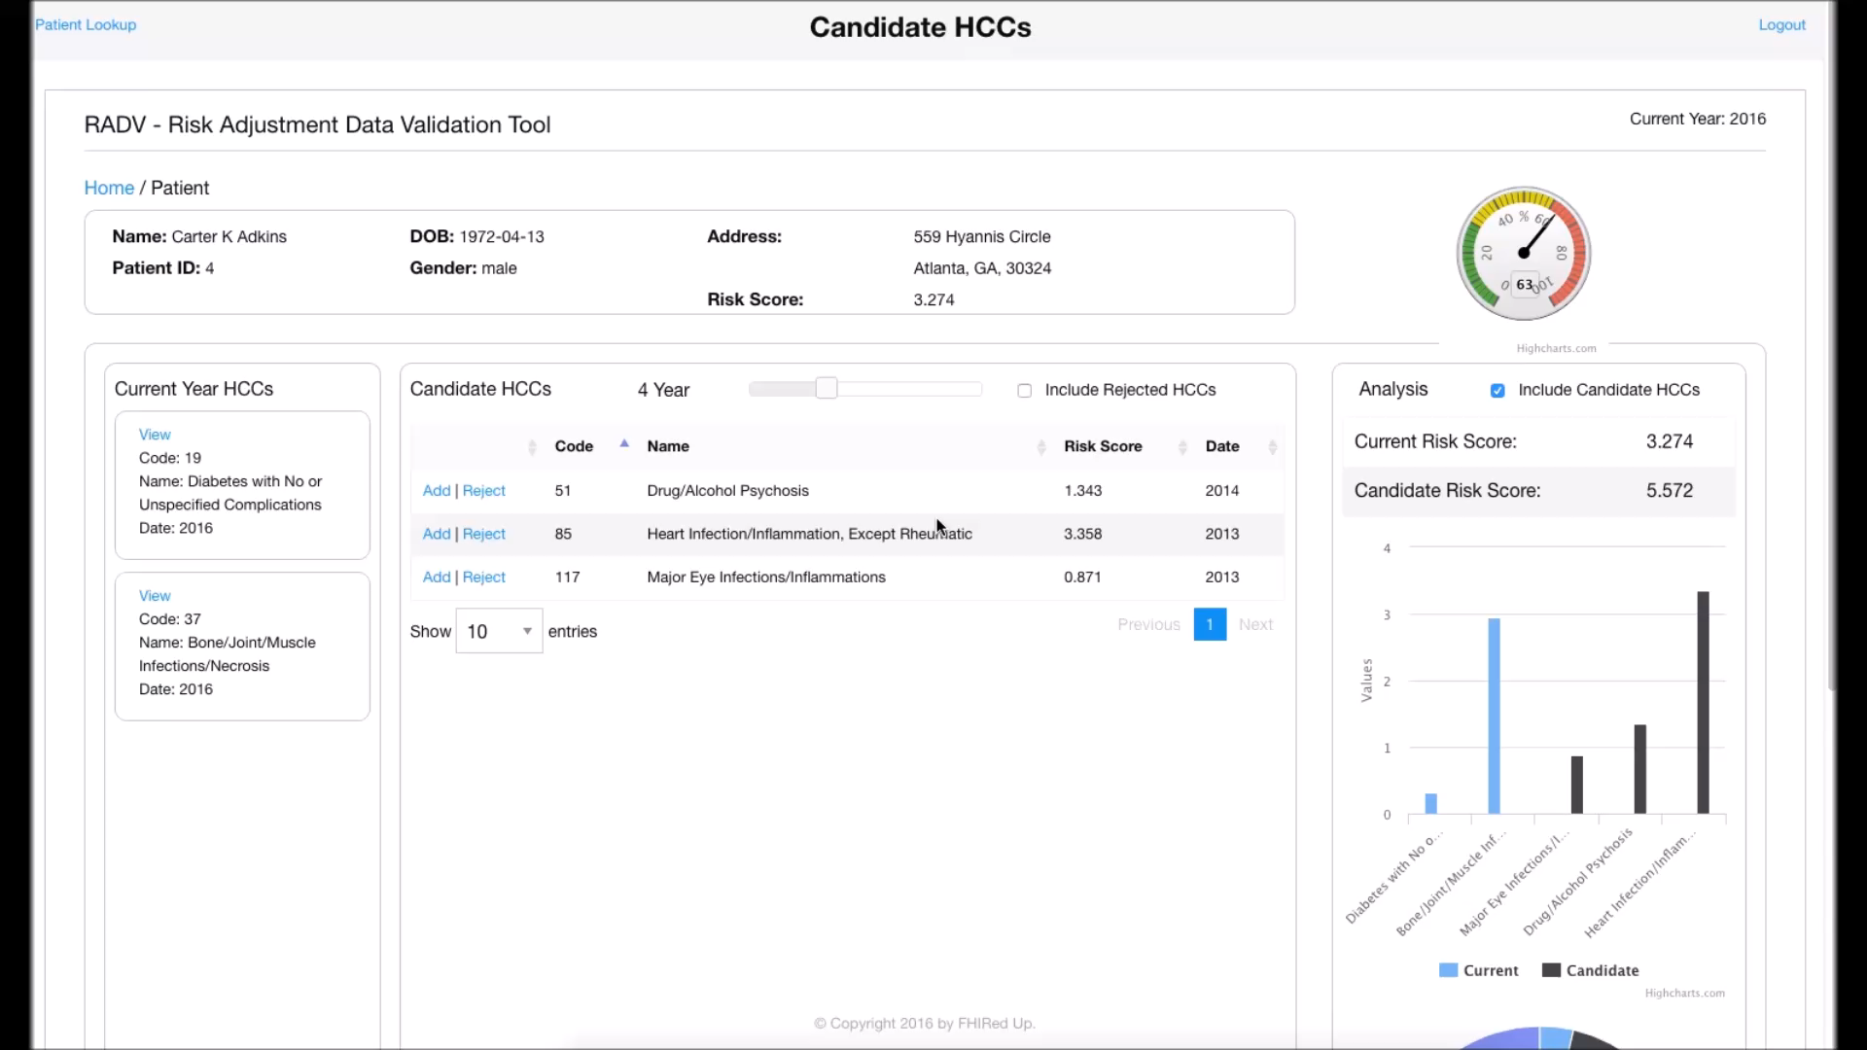
Notes:
We are logged in to the RADV application and are looking at Carter Adkins records for the year which includes his historic and current HCC’s. We can see that his current Risk Score is 63 indicating that his current risk score is 63% lower than in past years. As a doctor overseeing Mr Adkins I can look through his history and see that I should check for Heart Infection/Inflammation, Except Rheumatic. After checking his heart I now wish to record the HCC so I click add and select the SnowMed codes applicable. When I save the HCC the Risk Score is recalculated and the screen is updated with the new Risk Score.

